Slide 1
COMP1003 – Algorithms, Data Structures and Maths Lecture13 Syntax and Semantic
Thomas Wennekers
University of Plymouth

Slide 2
Main Ideas
To program a computer means to tell it what to do
This has to be done in some language
The computer is a stupid machine and very picky about syntax, ie. the precise form it is spoken to
Programming languages are formally defined, for example using syntactic rules
A single mistake following the rules can break code
Semantic gives meaning to code; it interprets words and constructs in a programming language

Slide 3
Why is this important ?
Many computer languages have similar constructs, which are absolutely fundamental in computing (arithmetic, logic, loops, if-then-else).
A good understanding of how computer languages are defined leads to more efficient code and coding.

Slide 4
Aims of the Lecture
To introduce Backus Naur Forms as a way to define programming constructs
To provide some examples, ie, natural language, arithmetic, or logic
To explain the two sides of code – syntax and semantic

Slide 5
Outline
A simple “natural” language
(Extended) Backus Naur Forms (EBNF)
Arithmetic expressions (5*x+7)
Boolean logic ( x && (y || z ) )
PL-0: a minimal programming language
Syntax & Semantic

Slide 6
A simple “natural” language
John sleeps .
Mary sings .
Bob has a dog .
The house is large .
A dog is an animal .
....

Slide 7
Language has structure
John sleeps .
Mary sings .
Bob has a dog .
The house is large .
A dog is an animal .
Sentence = Noun phrase and verb phrase .
S ::= NP VP .

Slide 8
.. but what is a noun phrase / NP ? ..
John sleeps .
Mary sings .
Bob has a dog .
The house is large .
A dog is an animal .
Noun phrase = Name or Determiner followed by Noun
NP ::= DET NOUN | NAME ;

Slide 9
.. but what are DET, NOUN, NAME? ..
John sleeps .
Mary sings .
Bob has a dog .
The house is large .
A dog is an animal .
DET ::= “a” | “the” ;
NAME ::= “John” | “Bob” | “Mary” ;
NOUN ::= “dog” | “house” | “animal” ;

Slide 10
A simple language
S ::= NP VP ;
NP ::= DET NOUN | NAME ;
DET ::= "a" | "an" | "the" ;
NOUN ::= "dog" | "house" | "pen" | "animal" ;
NAME ::= "John" | "Mary" | "Bob" ;
VP ::= "sleeps" | "sings" | "is" ADJ | “is” NP | "has" NP ;
ADJ ::= "large" | "red" | "scary" ;

Slide 11
Syntax versus Semantic
These are syntactically correct:
a pen is a pen .
a pen is an animal .
the house sings .
an pen is a animal .
EBNF only covers syntax (“form”), no meaning
The rules are strict (especially on computers!)
Semantic is, how language gets meaning (later more).

Slide 12
(Extended) Backus Naur Forms (EBNF)
used to express the structural form of languages
EBNF “rules” express syntactic elements in terms of other elements and “terminals”
“elements” are also called “syntactic variables” or “syntactic categories” (DET, NOUN, ADJ)
“terminals” are basically strings (“Mary”, “a”, “scary”)

Slide 13
A simple language
S ::= NP VP ;
NP ::= DET NOUN | NAME ;
DET ::= "a" | "an" | "the" ;
NOUN ::= "dog" | "house" | "pen" | "animal" ;
NAME ::= "John" | "Mary" | "Bob" ;
VP ::= "sleeps" | "sings" | "is" ADJ | “is” NP | "has" NP ;
ADJ ::= "large" | "red" | "scary" ;
red: syntactic variables
or categories
blue: terminals or
terminal symbols

Slide 15
Another Example
DIGIT ::= "0" | "1" | "2" | "3" | ... | "9" ;
INT ::= DIGIT+ ;
FLOAT ::= INT ("." INT? )? ;
“+” means “one or more of an expression”
“?” means “zero or one”; “*” means “zero or more”
correct: 1, 123, 007 , 2., 3.5, 345.213, 00.1234567
incorrect: -1 , +1 , 1.2.3 , 4..5 , .23

Slide 16
Arithmetic Expressions (5*7+3)
expression ::= term ( (“+” | “-” ) term )* ;
term ::= factor ( (“*” | “/”) factor )* ;
factor ::= number | "(" expression ")";
red : syntactic categories/variables
blue : terminals (must appear literally in an expr.)

Slide 17
Arithmetic Expressions (5*7+3)
Only look at this first :
expression ::= term ( (“+” | “-” ) term )* ;
term ::= factor ( (“*” | “/”) factor )* ;
factor ::= number ;
Syntactically correct expressions:
3 3+4 3*5+6 3*5 + 6/7*8 + 1
Syntactically incorrect expressions:
+3 4**5 *4+1

Slide 18
Arithmetic Expressions, eg. (5*7+3)
These rules are “recursive”
expression ::= term ( (“+” | “-” ) term )* ;
term ::= factor ( (“*” | “/”) factor )* ;
factor ::= number | "("expression ")" ;
Syntactically correct:
(((1))) (1+4) ((1+3*(4/(7)+2)/4)/5)
Syntactically incorrect:
((1) (1+2)(3*4)

Slide 19
Boolean Logic, e.g. (a && b || c )
bool_exp ::= or_exp ( “||” or_exp )* ;
or_exp ::= atom ( “&&” atom )* ;
atom ::= IDENT | ”false | “true” | “(“ bool_exp “)” ;
IDENT ::= “a” | “b” | “c” ;
Syntactically correct
false a && b || c b || ( a && a ) a || true
Syntactically incorrect:
'true' a&b && c d
Note: no NOT operator → incomplete logic

Slide 20
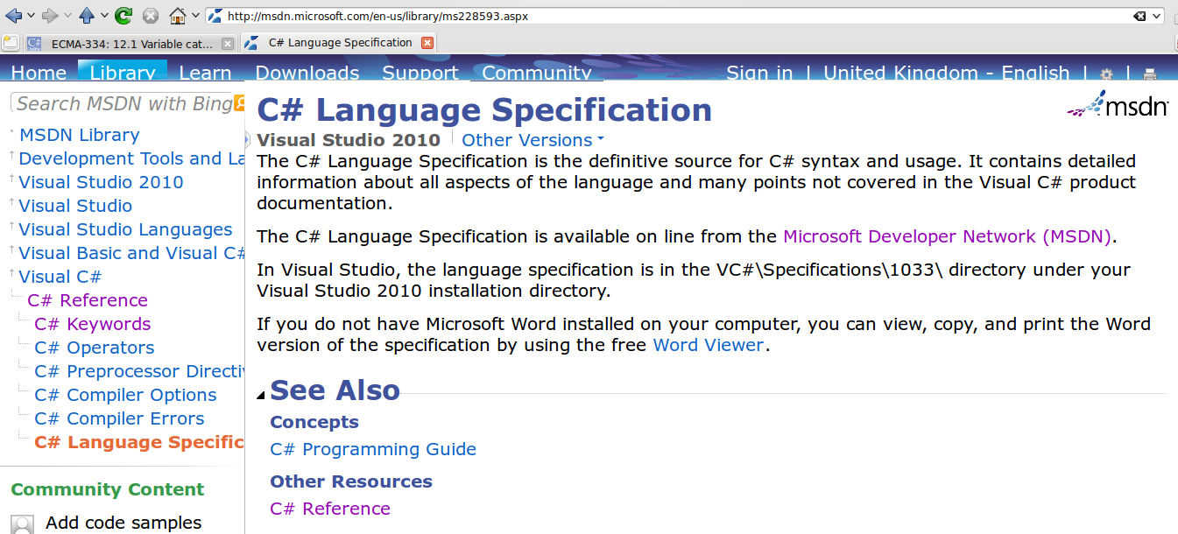
C#
Official specification is a mix of EBNF and informal information

Slide 21
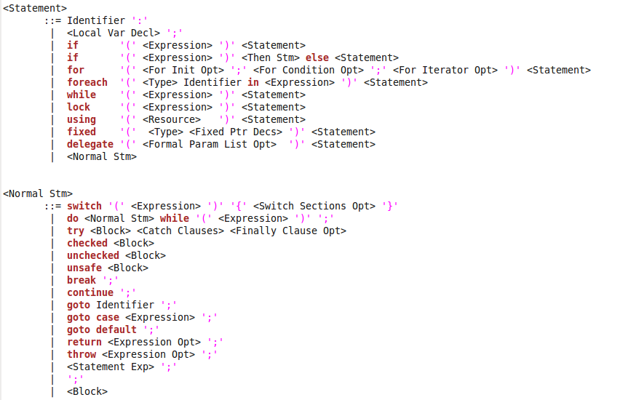
C# Statements

Slide 22
C# Statements

Slide 23
Basic Programming Constructs
MS Visual Studio and other compilers know the rules
Therefore they detect many errors (wiggly lines)
.. and can suggest code completion
You need to learn the rules as well !!
They are similar for many programming languages

Slide 24
Basic Programming Constructs
- simple types int, float, bool
- arithmetic 2*5-3
- Boolean logic a && b || c
- statements
conditional if-then-else
loops for, while
assignments x = 3+b
blocks
jumps
- functions int func ( int x )

Slide 25
Basic Programming Constructs
By now you must have learned these basic programming constructs
There is little need for more C# in COMP1003
See also the C# Primer on the DLE

Slide 27
Syntax versus Semantic
You don't understand a language that you have not learned. It's just a stream of utterances.
Even if you know the syntax, you still don't know the meaning, because you don't know the meaning of the words ("Ich bin ein Berliner").
Semantic looks at how language comes to mean something.
In natural language words (“symbols”) refer to real things and syntactic rules aim at expressing something about the subject.

Slide 28
Syntax and Semantic of Computer Code
Similarly as natural language, in the first place computer code is just a stream of senseless bytes without any meaning.
Syntax structures the data stream, but does not put meaning into it:
… the house sings … a pen is an animal …
Computer code needs to be semantically “grounded” just as natural language
There are different possibilities ...

Slide 29
The Meaning of Code I
“Informal semantic” – keywords and constructs are interpreted in a common sense way.
Everybody “knows” what "2*3+5" means from school. This gives the syntactic pattern meaning.
“Machine semantic” – constructs are defined relative to a machine that executes them, for example a CPU:
2*3+5 in the simplest case may refer to the “add” and “mul” CPU instructions and registers

Slide 30
The Meaning of Code II
“Operational semantic” - code may be executed by a program directly (called “interpreter”). The meaning of a construct is then the operation it causes the interpreter to do, i.e. to compute 2+4=6 (most scripting languages work like this).
“Compiler semantic” – a language can be interpreted relative to another one; a compiler translates code from one language to another.
[Example: “javac” calls a compiler; “java” an interpreter (of byte code); similar with SLI in C#.]
… there are some more code interpretations …

Slide 32
Outcomes
An idea about what Backus Naur Forms are and how they can be used to define a (computer) language.
Several examples of language elements (artithmetic, logic) including examples of correct and incorrect expressions they define.
Understanding of the difference between syntax and semantic and the way computer code gets to mean something.

